Slide 1
Lecture 16: Memory Layout – Stack vs Heap
Class page: https://github.com/tsung-wei-huang/cs1410-40
Dr. Tsung-Wei Huang
Department of Electrical and Computer Engineering
University of Utah, Salt Lake City, UT

Slide 2
Memory Layout
Stack vs Heap

Slide 3
Stack
The place where arguments of a function call are stored
The place where registers of the calling function are saved
The place where local data of called function is allocated
Automatic data
The place where called function leaves result for calling function
Supports recursive function calls
…

Slide 4
Stack
Imagine the following program:–
int factorial(int n){
if (n <= 1)
return (1);
else
int y = factorial(n-1);
return (y * n);
}
Imagine also the caller:–
int x = factorial(100);
What does compiled code look like?

Slide 5
Compiled Code: Caller
int x = factorial(100);
Put the value “100” somewhere that factorial function can find
Put the current program counter somewhere so that factorial function can return to the right place in calling function
Provide a place to put the result, so that calling function can find it

Slide 6
Compiled Code: Factorial Function
Save the caller’s registers somewhere
Get the argument n from the agreed-upon place
Set aside some memory for local variables and intermediate results – i.e., y, n - 1
Do whatever factorial was programmed to do
Put the result where the caller can find it
Restore the caller’s registers
Transfer back to the program counter saved by the caller

Slide 7
Somewhere?
So that caller can provide as many arguments as needed (within reason)?
So that called routine can decide at run-time how much temporary space is needed?
So that called routine can call any other routine, potentially recursively?

Slide 8
Answer: a Stack
Stack – a linear data structure in which items are added and removed in last-in, first-out order.
Calling program
Push arguments & return address onto stack
After return, pop result off stack

Slide 9
Stack with Called Routine
Called routine
Push registers and return address onto stack
Push temporary storage space onto stack
Do work of the routine
Pop registers and temporary storage off stack
Leave result on stack
Return to address left by calling routine

Slide 10
Stack
All modern programming languages require a stack
Fortran and Cobol did not (non-recursive)
All modern processors provide a designated stack pointer register
All modern process address spaces provide room for a stack
Able to grow to a large size
May grow upward or downward

Slide 11
Heap
A place for allocating memory that is not part of last-in, first-out discipline
I.e., dynamically allocated data structures that survive function calls
E.g., strings in C
new objects in C++, Java, etc.

Slide 12
Allocate Memory from Heap
malloc() – POSIX standard function
Allocates a chunk of memory of desired size
Remembers size
Returns pointer
free () – POSIX standard function
Returns previously allocated chunk to heap for reallocation
Assumes that pointer is correct!

Slide 13
Allocate Memory from Heap
malloc() – POSIX standard function
Allocates a chunk of memory of desired size
Remembers size
Returns pointer
free () – POSIX standard function
Returns previously allocated chunk to heap for reallocation
Assumes that pointer is correct!
Storage leak – failure to free something

Slide 14
Heap in Modern Systems
Many modern programming languages require a heap
C++, Java, etc.
NOT Fortran
Typical process environment
Heap grows toward stack — but never shrinks!
Multi-threaded environments
All threads share the same heap
Data structures may be passed from one thread to another.

Slide 15
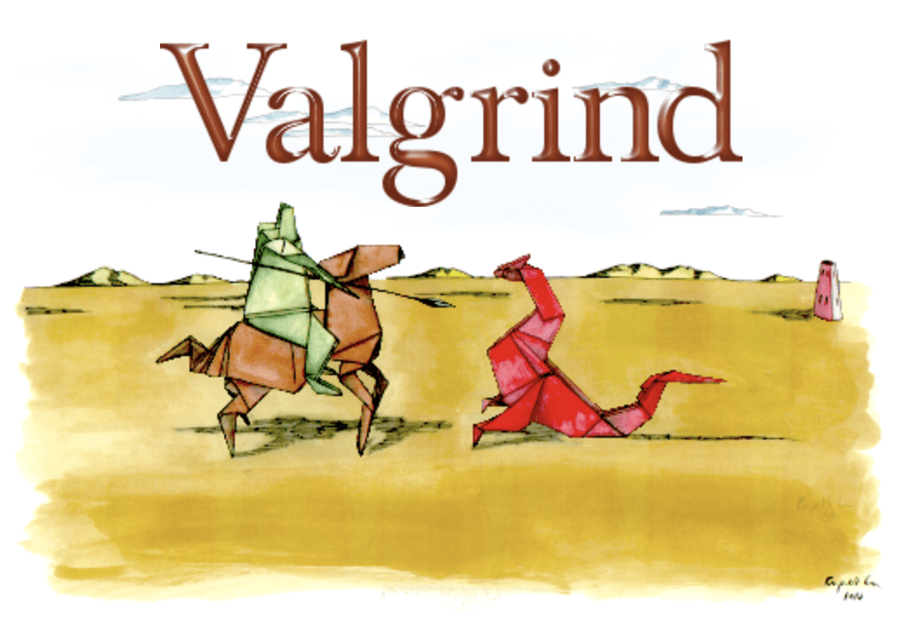
How to Detect Memory Leak?
https://valgrind.org/

Slide 16
Summary
Memory layout
Stack
Heap

